Slide 1
Welcome!
Phonics and Maths in EYFS
Notes:
Labelling clothing
Spare clothes
Waterproofs/wellies
Book bag

Slide 2
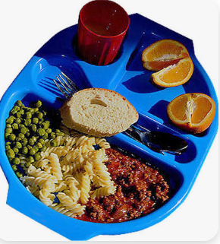
Aims of this meeting
To discuss the first half term of school and our daily routine.
Practicalities, uniform and lunches.
Upcoming dates and events.
To share how we teach phonics and maths in Reception.
To discuss how you can support your child’s learning at home.
All information in this presentation will be emailed out to you this week.
Notes:
Labelling clothing
Spare clothes
Waterproofs/wellies
Book bag

Slide 3

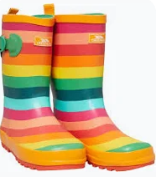

Practicalities, uniform and lunches
We have had a fantastic start to our Autumn term!
Please provide a puddlesuit, wellies and labelled spare clothes for our messy play.
We kindly ask that water bottles only have water in them to drink at school.
If your child has a packed lunch, we ask that this is a healthy meal – children are unable to have crisps, chocolate or fizzy drinks at school.
When collecting your child, we kindly ask that families wait behind the wooden posts of our shelter – we will dismiss your child to you when we see you.
Our PE day is a Tuesday, we ask that children come in wearing their PE kit on these days (navy t-shirt and joggers/shorts).
Notes:
Labelling clothing
Spare clothes
Waterproofs/wellies
Book bag

Slide 4
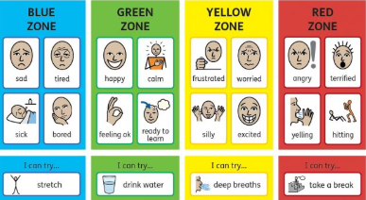
Zones Of Regulation
This term we are introducing ‘zones of regulation’, this supports children to identify their feelings using colour zones and teaches regulation strategies.

Slide 5

Phonics

Slide 6
Phonics is:
making connections between the sounds of our spoken words and the letters that are used to write them down.
Notes:
It sounds complicated but it really isn’t!

Slide 7
Phase 1 phonics
Phase 1 phonics is an essential step in children learning to read.
In this phase, children learn rhyme and rhythm through nursery rhymes, the initial sounds of objects and oral blending.
We continue to practise phase 1 skills, such as identifying initial sounds and orally blending words as we begin phase 2.

Slide 8

Little Wandle Letters and Sounds Revised
Our school has chosen
Little Wandle Letters and Sounds Revised as our systematic, synthetic phonics (SSP) programme to teach early reading and spelling.

Slide 9


Teaching order
Notes:
We usually teach four new sounds a week and have a review lesson on a Friday. You will get a list of the sounds that we are learning to have at home. This will help you with formation and pronunciation.

Slide 10
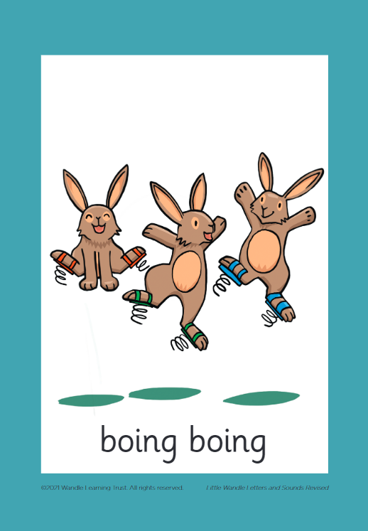



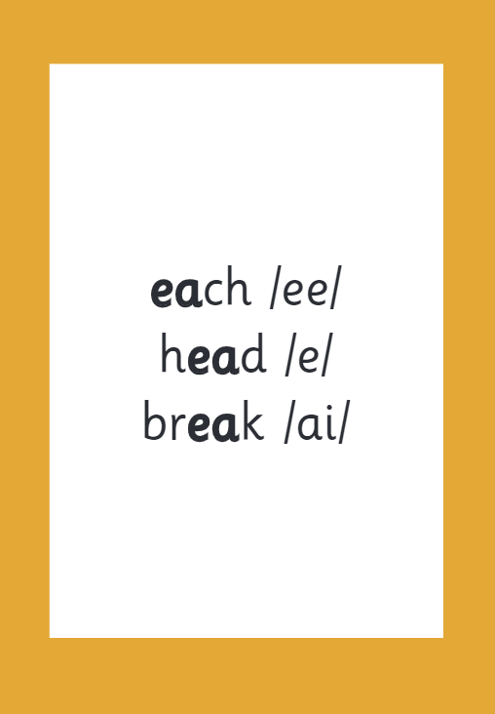

How we make learning stick
Notes:
There are specific resources for the Little Wandle Programme which the children will be very familiar with. Each sound that we teach to begin with has either a mnemonic (like the astronaut that you can see here) or a phrase like boing-boing for ‘oi’. This helps the children recognise and remember the graphemes. Every time we teach a new sound, we also read words during the phonics lesson that contain that new sound so that the children practise what they have learned. We then go on to reading a sentence containing some of those words. We have displays in the classroom and on the tables to support the children throughout the day.

Slide 11

Blending to read words
Notes:
Some children learn to blend really quickly, and others take a little longer. If your child is finding it difficult, ask your child’s teacher for ways to help at home – playing blending games at home is so helpful!
Show parents this video from the website: https://www.littlewandlelettersandsounds.org.uk/resources/for-parents/

Slide 12
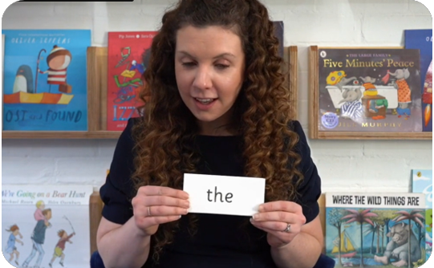
Tricky words
These words have unusual spellings e.g. he, the, was.
They are taught in a systematic way.
Children have learned to read the Phase 2 tricky words: is, I, the
Notes:
Slide purpose:
To introduce tricky words
Notes:
Read the slide.
You may wish to give parents a copy of the document ‘Phase 2 tricky words: Reception Autumn term – Information for parents and carers'.

Slide 13

Spelling
Say the word.
Segment the sounds.
Count the sounds.
Write them down.
Notes:
Model the process on a flipchart for the parents to see.

Slide 14
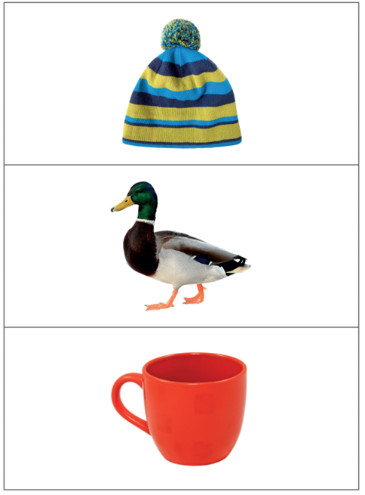

Slide 15
What to practise at home?
1.Practise sounds regularly and model how to say the sound correctly
2. Practise hearing sounds at the beginning of words – e.g. I Spy
3. Orally blend sounds (without seeing letters)
4. Practise letter formation – on grapheme sheet

Slide 16
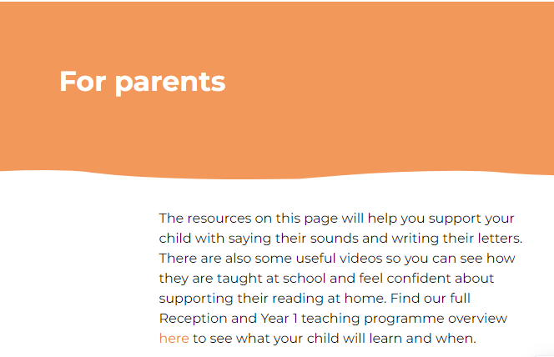
Little Wandle website
Letters and Sounds | A complete Phonics resource to support children (littlewandlelettersandsounds.org.uk)

Slide 17
Reading at home

Slide 18

The most important thing you can do is read with your child
Reading a book and chatting had a positive impact a year later on children’s ability to…
understand words and sentences
use a wide range of vocabulary
develop listening comprehension skills.
The amount of books children were exposed to by age 6 was a positive predictor of their reading ability two years later.
Parental involvement in the development of children’s reading skills: A five-year longitudinal study (2002) Senechal, M. and Lefvre, J
Notes:
Celebrate child’s success at school, make time for reading at home!

Slide 19



Books going home
Notes:
As well as the ‘learning to read’ book that your child will bring home they will also bring home a book for sharing with you. This book is SO important. This is how we are going to give them the WILL to read. Please read with your child as often as you can – at least once a day if possible.

Slide 20
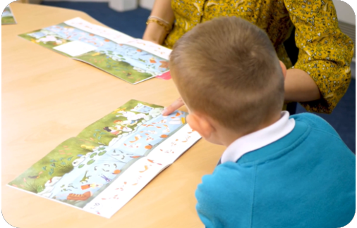
Reading a wordless books
Wordless books are invaluable as they teach reading behaviours and early reading skills to children who are not blending – yet!
Talk about the pictures.
Point to the images in the circles and find them on the page.
Encourage your child to make links from the book to their experiences.
Notes:
Slide purpose:
To give guidance on reading wordless books at home
Notes:
Read the slide.

Slide 21

Read to your child
The shared book is for YOU to read:
Make the story sound as exciting as you can by changing your voice.
Talk with your child as much as you can:
  Introduce new and exciting language
  Encourage your child to use new vocabulary
  Make up sentences together
  Find different words to use
  Describe things you see.

Slide 22
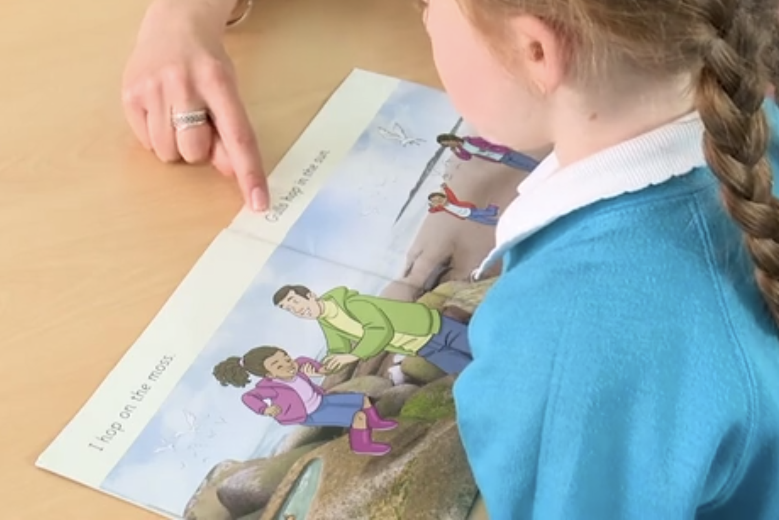
A reading book at the right level
This means that your child should:
Know all the sounds and tricky words in their phonics book well
IDEALLY… Only need to stop and sound out about 5% of the words by the time they bring the book home

Slide 23

We use assessment to match your child with the right level of book.
Notes:
We assess your child every six weeks to check progress. Any child who needs extra support has daily keep-up sessions planned for them.

Slide 24

Remember – to read, we want children to:
1.Know what letters make which sound.
2. Orally blending words.
Remember – to read, we want children to:​
Know what letters make which sound.
2. Orally blend words.
3. Recognise the tricky words.

Slide 25
Listening to your child read their phonics book
Your child should be able to read their book without your help.
They might sound out words and blend them before they read them fluently.
If they can’t read a word, read it to them.
Talk about the book and celebrate their success.
Notes:
Slide purpose:
To give guidance on reading the decodable book at home
Notes
Read the slide.

Slide 26
READING TOP TIPS!
When reading the shared book, love the experience and make it fun – your enthusiasm will rub off and inspire your child.
For the phonic book your child reads, if they get stuck stop and show them how to sound it out and try and blend.
Praise effort regardless of outcome ‘you tried so hard! Well done!’. Praising effort leads to children who try and take risks.
Pick a time that suits you both, so it is a positive experience.
Non-word books are amazing for vocabulary development and imaginative story telling/comprehension.

Slide 27

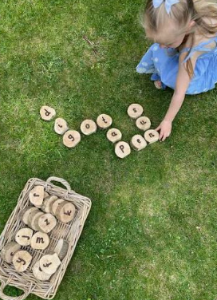
Our literacy morning
We would like to warmly invite families to a literacy morning on Friday 13th November.
This will be a fantastic opportunity to see how your child learns phonics at school through a short lesson followed by fun practical games.

Slide 28
Any reading or phonics questions?

Slide 29

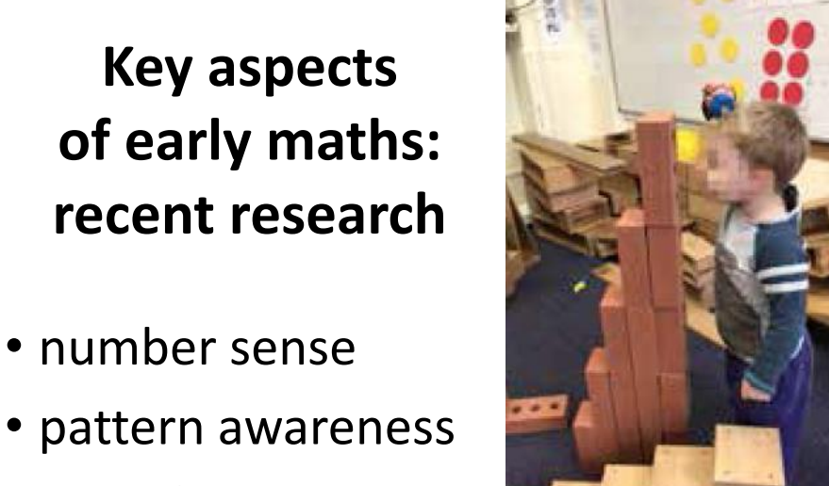

Slide 30
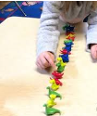
Number: counting
1:1 correspondence counting
Recognising that the last number in the group is how many there are altogether.
Counting orally beyond 10 and understanding the counting pattern.

Slide 31
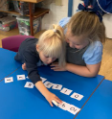
Number:
Numbers to 10 in depth.
Recognising numerals to 10 and being able to securely sequence numbers to 10.

Slide 32
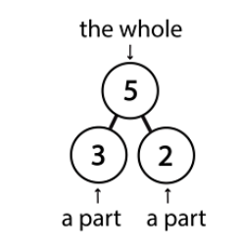
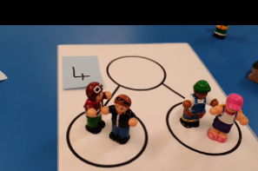
Number: composition
Understanding of composition within 10, including practical adding.

Slide 33



Subitising
Subitising numbers to 5 in different arrangements.
Identifying how many without 1:1 counting.

Slide 34
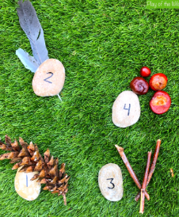
Number: comparing
Using language of more, less, greater, fewer.
Comparing number and quantities.

Slide 35
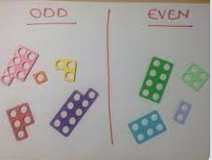
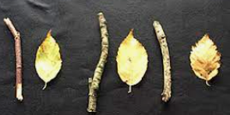
Pattern
Repeating patterns.
Number patterns, doubling, halving, odds and evens.

Slide 36


Shape, space and measure
2D shapes
Capacity
Height and length

Slide 37
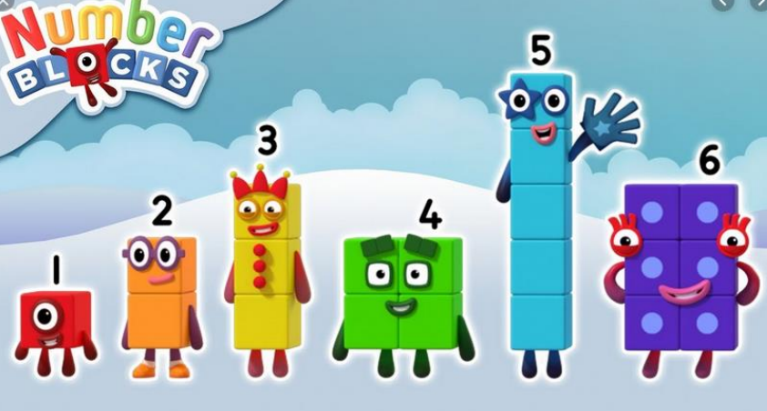
Numberblocks

Slide 38
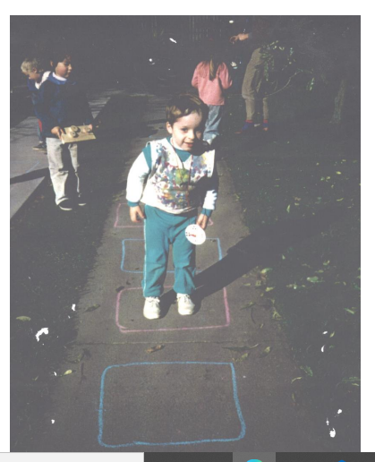
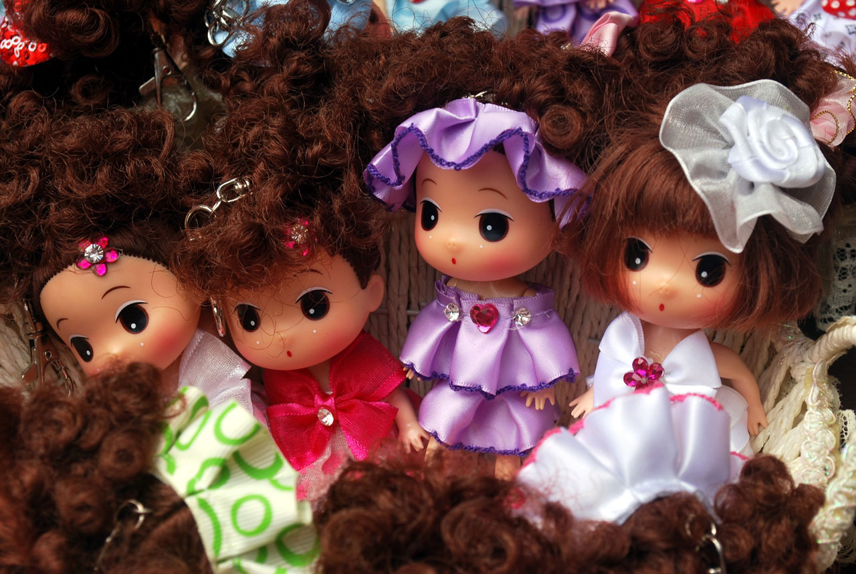
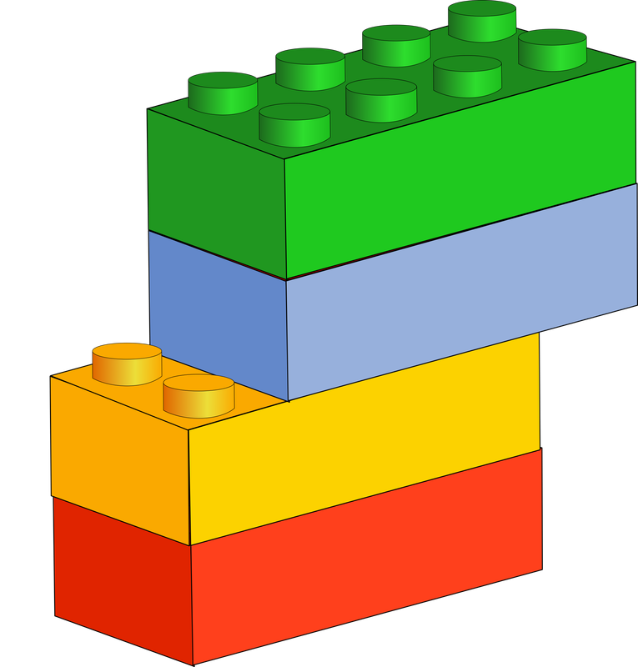
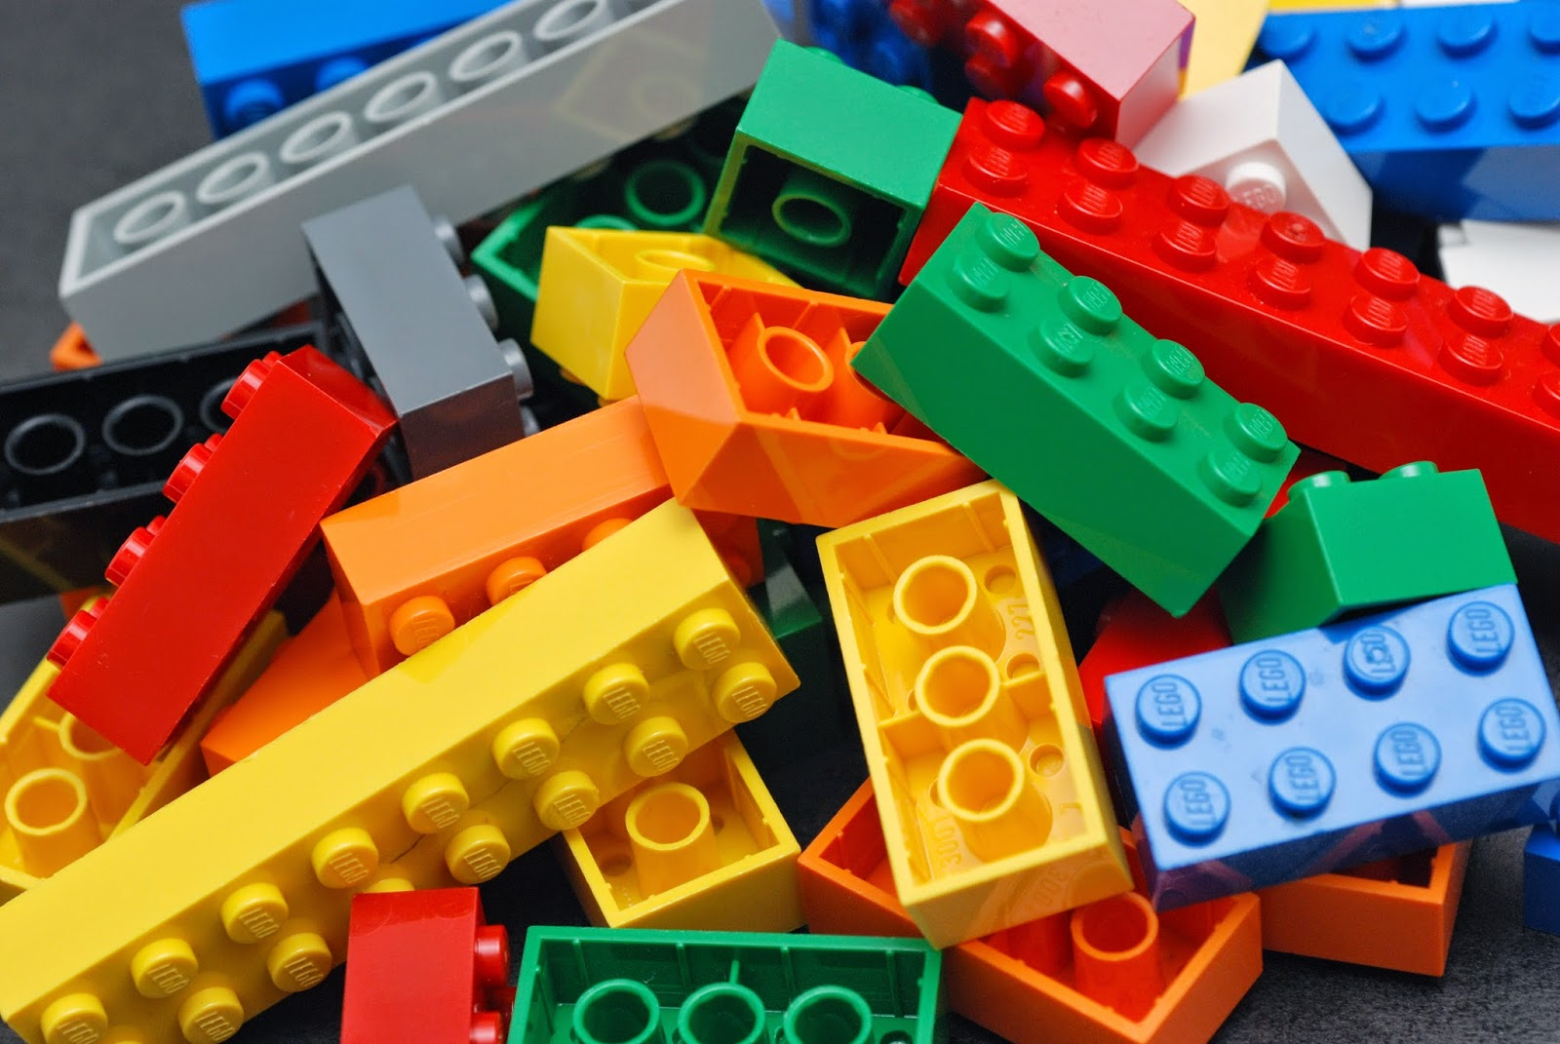
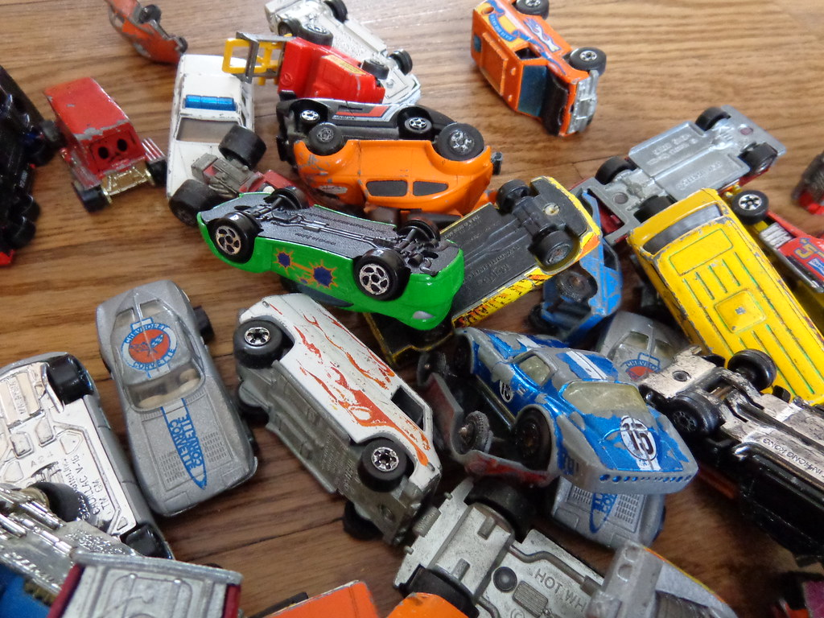
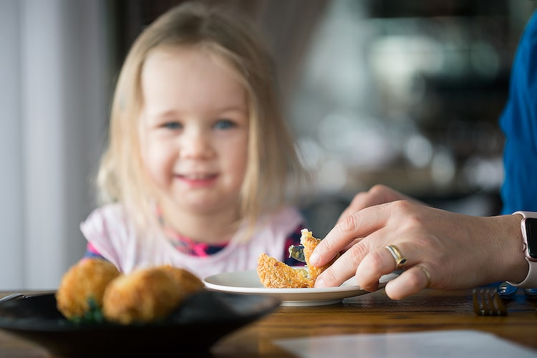

Opportunities everywhere…
.
This Photo by Unknown Author is licensed under CC BY-SA-NC
This Photo by Unknown Author is licensed under CC BY
This Photo by Unknown Author is licensed under CC BY

Slide 39
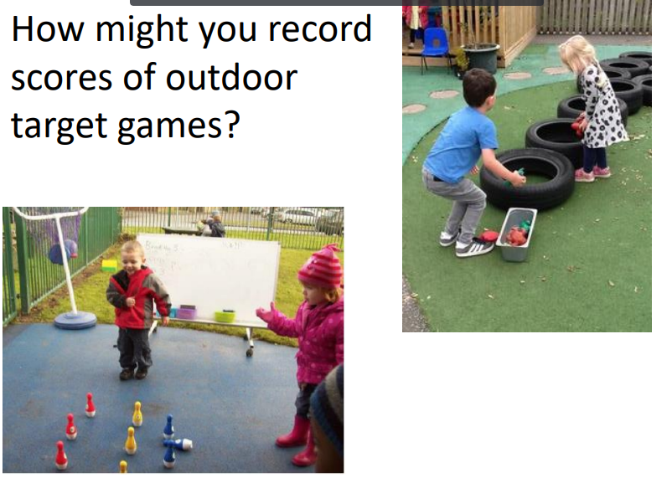
Counting jumps, steps, hops etc.
Play board games that include 1 or 2 dice

Slide 40


Slide 41
MATHS
Use the app ‘Numbots’ for number fluency (if you can). The password is in your pack
Count, count and… count! Find opportunities to count and compare
Notice numerals and discuss how big or small the value of the numbers are
Hands on maths! Making cakes, filling containers, sand and mud play etc.
Pick a pair – quantities to numerals (make dot cards and number cards). Can the child then order all the numbers?
Games, games, games

Slide 42
Any questions?

